Slide 1



System Dependency Modeling Tool
Community Coordinated Modeling Center
Patrick Zhou
University of Maryland, College Park
Science and Engineering Student Internship
Chemical Engineering/Computer Science Double Degree

Slide 2


Presentation Overview
Sun and the Earth - Background
CCMC – What It Does, Why We Need It
Role in the CCMC – My Connection and Project Goal
Project Overview – Development and Conceptualization
Program Demonstration – Current Build
Summary – Future Plans

Slide 3
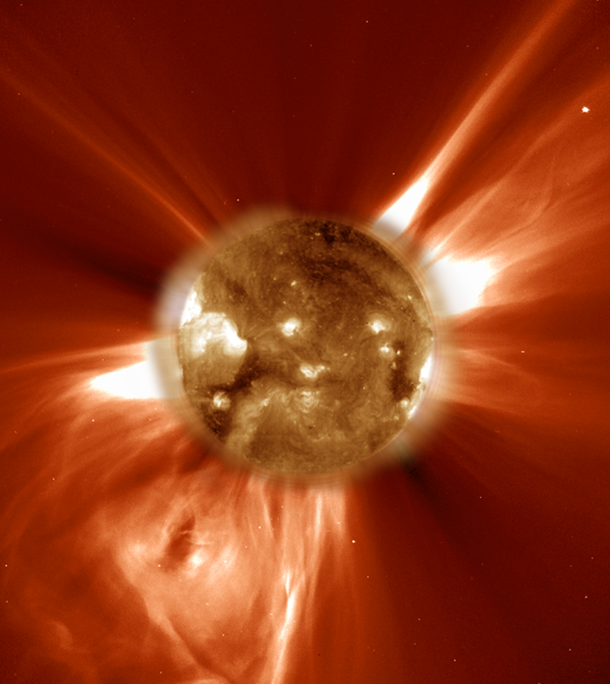
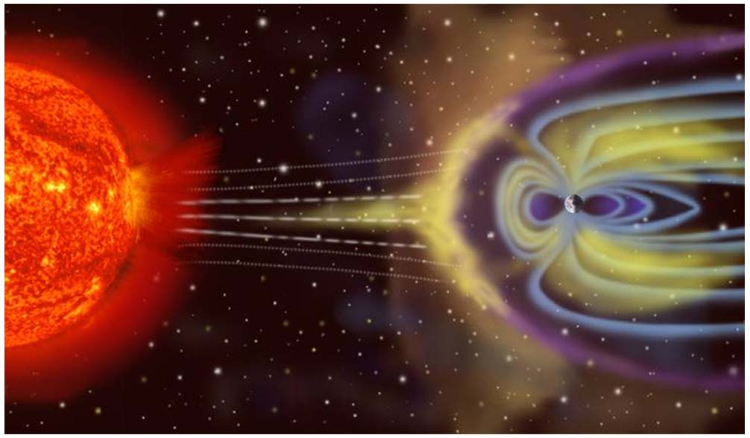
Sun-Earth Connection
The Sun is the source of all space weather
  Solar flares and Coronal Mass Ejections (CME) pose a threat to power grids
  Satellite failures (Reduced Lifetime)
  Communications and GPS blackouts
  Particle hazards to astronauts and polar flight passengers
CCMC develops models to help predict space weather and prevent endangerment to property and human well-being

Slide 4
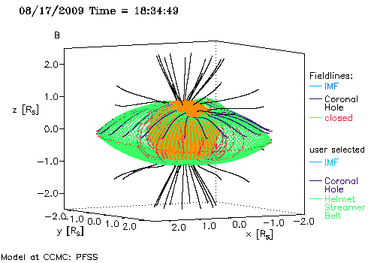
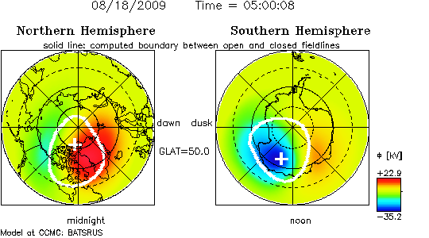
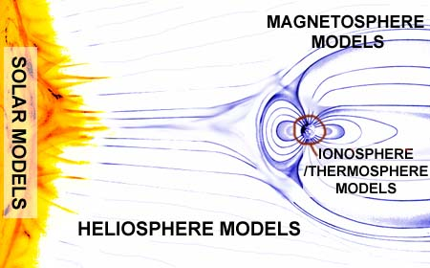
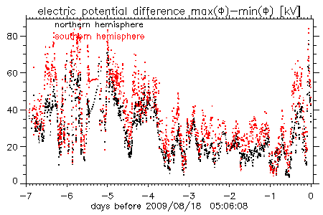
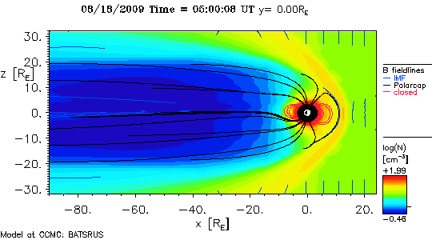
What is the CCMC? Why is it needed?
The Community Coordinated Modeling Center (CCMC) is a multi-agency partnership
  Enables, supports, and performs research and development for next-generation space science and space weather models.

Slide 5
Role in the CCMC
Model processing runs handled by numerous servers
  “Spaghetti-like” dependency of resources
  System failures on a particular server/disk may cause multiple failures of real-time model runs.
  Ex:
Model of the system needed to map out dependencies
  Facilitate and create a functional tool that will effectively portray the relations of the system and its resources.
  Must be flexible and user-friendly

Slide 6
Project Overview
Eclipse IDE – Java
Hierarchy of System Objects
  Hardware
    Server (Processors)
    Filesystem (Disks)
  Resources
    Scripts
    Files
    Licenses
Hierarchy of System Management
  Product
    Process
      Resources

Slide 7
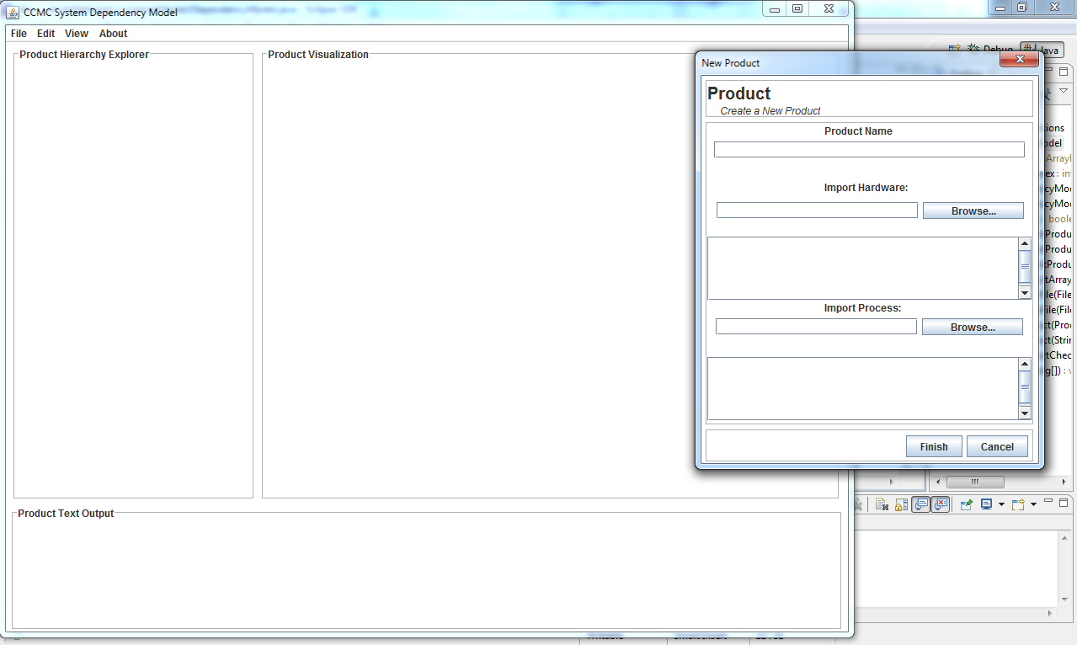
Project Demonstration
-Current Build-

Slide 8
Summary
Decision to integrate tool with GUI gives user greater flexibility and control
  Allows custom dependencies
  Allows import of pre-made products, resources
Better visualization of the relationship between systems resources
Easily pinpoint and identify problems when product runs crash
Future Plans
Finish User Interface
Add Advanced Functionalities
Implement visualization
  http://flare.prefuse.org/launch/apps/dependency_graph

Slide 9
Special Thanks
Mentor – Peter MacNeice
Director of CCMC – Michael Hesse
David Berrios & Marlo Maddox
Rest of the CCMC
Cori Quirk
SESI

